Slide 1
CHAPTER 1: INTRODUCTION
Definition: A database is a collection of data with the following properties:
It represents certain aspect of the real-world.
Its data are logically related.
It is created for a specific purpose.

Slide 2
Definition: A database management system (DBMS) is a set of software that are used to define, store, manipulate and control the data in a database.
define – define data types, structures and constraints.
store – store data to support efficient access.
manipulate – perform retrieval and update operations using a query language.
control – control access to data.
Database System = Database + DBMS

Slide 3
A Brief History Note
Database technology has a history of about 50 years.
Database technology has gone through several generations of development.
First Generation: File systems, 50's – 60's
A typical file system consists of a set of independent files, and a number of application programs

Slide 4
An Example File System
A banking system may have
files for customers, saving accounts and checking accounts;
application programs to deposit and withdraw money, to find balance, etc.

Slide 5
Problems of File Systems (1)
It is difficult to support new applications. Two existing application programs:
(i) find customers who have a checking account
(ii) find customers who have a saving account
  Need a new program to find the customers who have a checking account and a saving account.

Slide 6
Problems of File Systems (2)
It has no centralized control of all data.
  Files are often created for a particular application.
  Files are created and managed independently.

Slide 7
Problems of File Systems (3)
There often exists severe data redundancy and inconsistency.
Checking_Account: Acct#, Owner_name, Owner_SSN, Owner_Addr, Balance, ...
Saving-Account: Acct#, Owner_name, Owner_SSN, Owner_Addr, Balance, Interest, …

Slide 8
Problems of File Systems (4)
It lacks concurrency control.
Concurrency control: prevent mutual interference of concurrent requests.
Example (Airplane ticket reservation): Consider the situation when two customers are trying to book the only ticket left for a flight through two operators at about the same time.

Slide 9
Problems of File Systems (5)
Weak security
Cannot provide multiple views of the same data
Lack isolation between program and data
Lack self-describing feature

Slide 10
Database History (Continued)
Second Generation: Hierarchical database systems (HDBS), late 60's – early 70's
Best known HDBS: IMS (Information Management System of IBM).
One-to-many relationships between parent records and child records.
Records are connected by pointers.
Department
Student
Faculty

Slide 11
An IMS Query
Query: find all Binghamton University students whose major is computer science and whose GPA is higher than 3.5.
GU University (Name = `Binghamton University')
Department (Name = `Computer Science')
Student (GPA > 3.5)
L1: GNP Student (GPA > 3.5)
Goto L1

Slide 12

History of Database (Continued)
Third Generation: Network database systems (NDBS), late 60's – early 70's
Some commercial NDBSs: IDS II (Honeywell), DMS II (UNISYS).
Record types are organized into an acyclic graph.
Main problem with HDBS and NDBS: difficult to use.
Charles W. Bachman received
Turing Award for his work on IDS
(Integrated Data Store) in 1973.

Slide 13

History of Database (Continued)
Fourth Generation: Relational database systems (RDBS), early 70's – now
Example relational DBSs: Oracle, MySQL, Sybase, Informax, DB2, Ingres, ...
In RDBS, data are organized into tables (relations).
Edgar F. Codd received Turing Award
for inventing the relational data model
in 1981.

Slide 14
Example of Relations
Employees: Emp# Name Dept_Name
123 Bill Sales
234 Bob Service
Departments: Name Location Manager
Sales XY St. John
Service XZ Rd. Mary
Query: Find the manager of Bill.

Slide 15
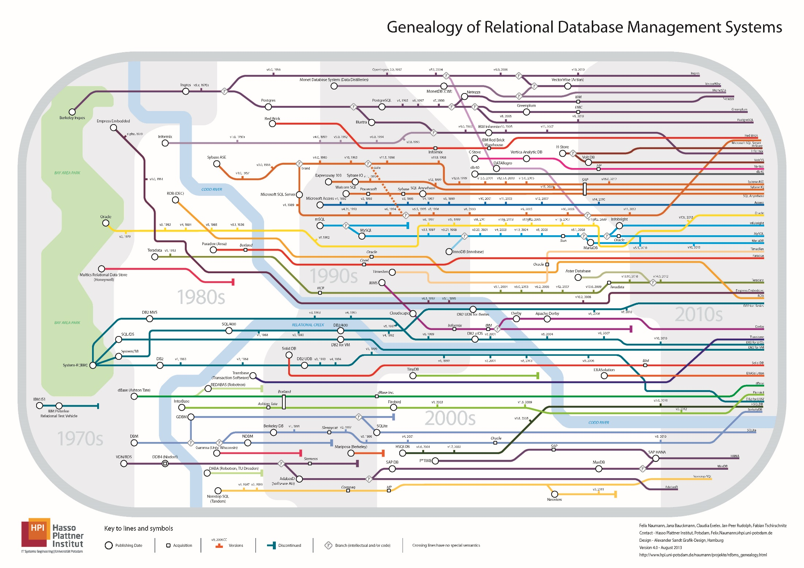
Genealogy of Relational DBMS

Slide 16
History of Database (Continued)
Fifth Generation: Object-oriented and Object-Relational database systems (OODBS), 80's -- now
Example OODBSs: O2, Objectivity, ObjectStore, Versant, …
Example ORDBSs: Oracle 8 (or later version), Informix, UniSQL/X.

Slide 17
Database Architecture
External External . . . . External
Schema 1 Schema 2 Schema n
Conceptual Schema
Internal Schema

Slide 18
Database Schema (1)
Definition: Database schema is the description of the user data in the database.
In relational model, a database schema consists of a set of tables.
Conceptual schema: logically describes all data in the database

Slide 19
Database Schema (2)
Internal schema (Physical schema): describes how data in the database are actually stored
External schema (User view): Each external schema provides a description of a portion of the data in the database which are interested in or can be accessed by a special group of users.

Slide 20
Advantages of the Three-Level Architecture
Easier for users to understand and use the database.
Provides a mechanism for access control.

Slide 21
An Example
Conceptual schema: Employees: Employee_number char(6)
Department_number char(4)
Salary numeric(5)
Internal schema: Stored_Emp: length = 20
Header Type = byte(6), offset = 0
Emp# Type = byte(6), offset = 6, Index = EMPX
Dept# Type = byte(4), offset = 12
Pay Type = byte(4), offset = 16
External schema 1: Emp_Pay: EMP# char(6)
SAL integer
External schema 2: Emp_Dept: EmpNo char(6)
DeptNo char(4)

Slide 22
Two Mappings
Two mappings are needed to process a user query:
From external schema to
conceptual schema
Example: EmpNo
Employee_number
From conceptual schema to
internal schema
Example: Employee_number
Emp#
External
Schema
Conceptual
Schema
Internal
Schema

Slide 23
Data Independence
Data Independence: the ability to modify the lower level descriptions of a database without causing application programs to be rewritten.
Logical Data Independence: the ability to modify the conceptual schema without causing application programs to be rewritten.
Physical Data Independence: the ability to modify the internal schema without causing application programs to be rewritten.
Data independence is achieved through proper manipulation of the above two mappings.

Slide 24
Database Languages
Data Definition Language (DDL): used by DBA or database designer to define database schemas.
Data Manipulation Language (DML): used by database users to retrieve, insert, delete and update data in the database.
  Query language: The part of DML that is used to retrieve data.
Data Control Language (DCL): used by database owners and DBA to control the access of data.

Slide 25
Two Types of DML
Procedural DML – a user is required to specify WHAT data are needed as well as HOW to get it.
Example: DMLs for hierarchical and network database systems.
Non-procedural DML – a user is required to specify ONLY WHAT data are needed but NOT HOW to get it.
Example: SQL

Slide 26
Procedural DML
Procedural DML is more difficult to use but usually has a better performance
Non-procedural DML is easier to use but usually suffers on performance
A better approach:
Non-procedural DML + query optimization

Slide 27
DBMS Architecture
User
Query Processor
Transaction
Manager
Storage Manager
Stored Data

Slide 28
Persons Involving DBS (1)
DBMS developers: Those who design and implement DBMS software: buffer manager, query processor, transaction manager, interface, ...
Database designers: Those who are responsible for determining
  what data should be stored in the database;
  how data in the database should be organized;
  the design of customized views;
  the design of special data structures to improve the performance of the system.

Slide 29
Persons Involving DBS (2)
Database administrator (DBA): Those who manage and monitor the daily operation of a database system.
  authorization for database access, e.g., who can access what data in what mode.
  routine maintenance: backup, install new tools, ...
  modification to existing database design.

Slide 30
Persons Involving DBS (3)
End-user:
  Expert users: those who access the database using SQL directly.
  Naive users: those who access the database using pre-prepared packages.

Slide 31
Persons Involving DBS (4)
Application programmers: Those who write menu applications for naive users, typically, through database calls embedded in a program.
System analysts: Those who determine the requirement of end users and develop specifications for canned transactions that meet the requirements.

Slide 32
After This Course, You Will Be
familiar with the relational data model;
a good database designer;
a sophisticated expert user of SQL;
a good application programmer;
knowledgeable with major aspects of DBMS development.

Slide 33
Overview of This Course
Database Design
  Entity-Relationship Model (Chapter 2)
  The Relational Data Model (Chapter 3)
  Transform ER schema to relational schema (Chapter 4)
  Table normalization (Chapter 5)
Database Programming
  Relational Algebra (Chapter 6)
  SQL (Chapter 7)
  PL/SQL (Chapter 8)
  ORDB Features (Chapter 9)

Slide 34
Overview of This Course (2)
Database Management System
  Index Structures and Index Creation (Chapter 10)
  Query Processing and Optimization (Chapter 11)
  Transaction Management (Chapter 12)
  Concurrency Control (Chapter 13)

Slide 35
Running Project
Student Registration System (SRS)
ER Schema Design
ER Schema to Relational Schema Transformation
Table Normalization
Application Implementation Using Oracle
  Table Population and Index Creation
  PL/SQL Coding
  JDBC

Slide 36
Other Database Related Courses
CS533: Information Retrieval (text database)
CS535: Introduction to Data Mining (OLAP)
CS538: Introduction to Multimedia Database Systems (Image, Audio, Video)
CS632: Advanced Database Systems
CS634: Web Data Management

